Slide 1


Today we are going to talk about cross joins
Illustrating it
How to do it on Microsoft SQL server
It’s disadvantages
Notes:
Hello, My name is Assem Ihab,
Welcome to my first SQL tutorial
Today we diving into the fascinating world of cross joins
We will talk about
How to doit on Microsoft sql server
It’s draw backs

Slide 2
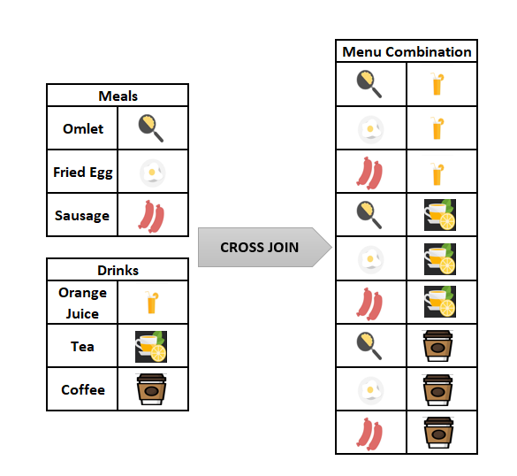
Here is a figure illustrating how a Cross Join works:
Notes:
here is a figure illustraining how a cross join works
By combining all possible types of food with all possible types of drinks in our kitchen

Slide 3
when to use cross joins
SELECT *
FROM Products
CROSS JOIN Colors;
Notes:
Here is a great example illustrating a use case for employing a cross join
The result from this query is a new table that contains every possible combination of 'Product' and 'Color'.

Slide 4
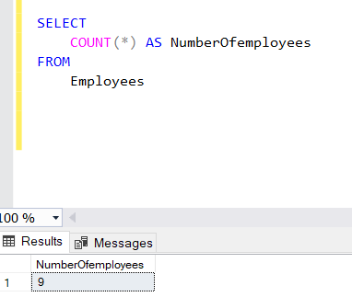
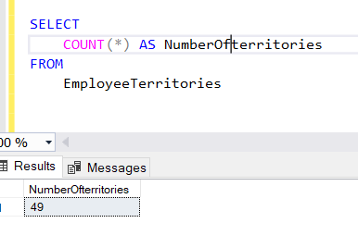
Number of territories
Number of employees
Notes:
Here is an example illustrating why you should avoid cross joins whenever possible.

Slide 5
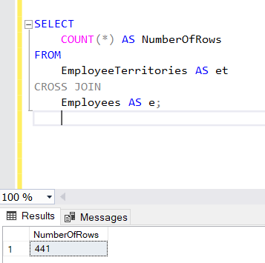
Total number of rows = 9*49
Notes:
Using a cross join could significantly increase query size and latency, and consume more memory.

Slide 6
Do we still need foreign keys when dealing with cross joins?
Notes:
Now it’s your turn
Do we still need foreign keys when dealing with cross joins?

